Slide 1
Test Strategy .
2025-04-23

Slide 2
Introduction
Transformation of B2B Services (from TOKA and SPOCK) to Salesforce Communication Cloud (SFCC)

Slide 3
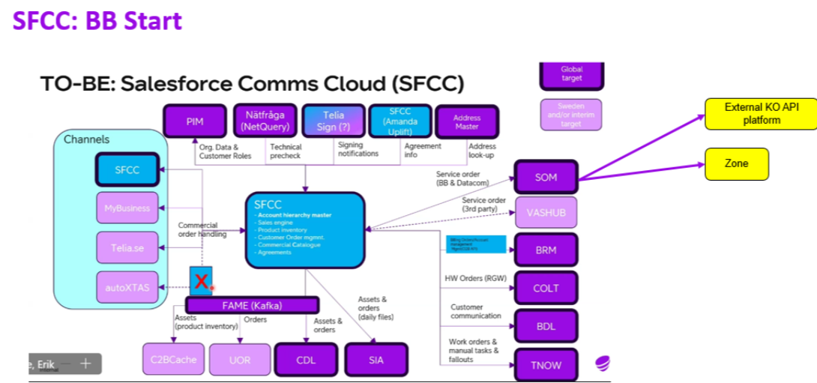
Scope
The user stories, functional specifications, and defects for the solutions being used will determine the testing's scope for each sprint-
Applications in Scope
SFCC
SFCC Amanda (Uplift)
SFCC integrations with legacy applications

Slide 4
Test Phase in scope-
Functional Testing (System Test)/SIT ?
Regression Testing
Manual and Automation testing
UAT Support
Activity | Details
Functional Testing - New Stories | All scenarios mentioned in the Acceptance Criteria to be covered in ST. Any scenario not tested on ST should have a valid reason and such cases should be covered in AT. Test Data to be managed with the help of Telia-on need basis if any.
Regression Testing | Due to multiple code deployments in ST phase, ST teams should plan to execute regression tests during ST period.
UAT Support | During UAT phase required support will be provided on clarification on functionalities and support to unblock the execution with help of Dev and Test teams.
Test Phases

Slide 5
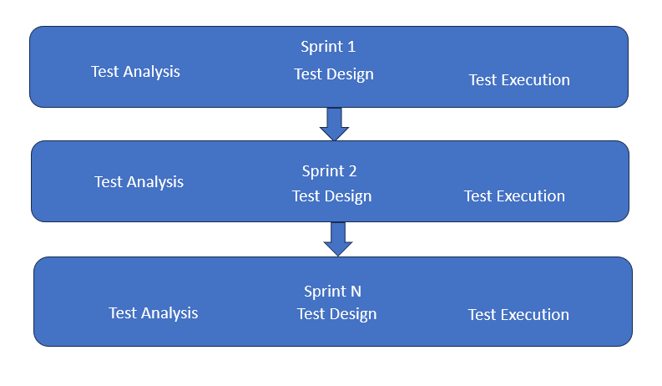
Testing activities will be conducted iteratively across 12 sprints.
Shift Left approach -Test design, preparation, and Execution to start within the sprint.
Review test cases with BA / product owner and approve.
Test Management and Execution- JIRA/XRAY.
Regression test Suite (Manual and Automation)
Identify regression cases from current Sprint and update regression test suite – per sprint.
Feasibility check will be done on identified regression test cases for automation and script development will be done in N+1 sprint.
Regression test cases will be executed as per functional impact.
Defect Management- XRAY
Defects to be logged with severity, development team, sprint.
Open Defects to be updated on daily basis.
Track test progress in Jira dashboards.
Approach

Slide 6
Entry Criteria & Exit Criteria
Entry Criteria & Exit Criteria
Entry Criteria-
User stories with Acceptance criteria and definition of done marked as “Ready For Test”.
Development of User stories to be completed and unit test result uploaded in JIRA.
Dev Handover to testing team- walkthrough, share open items/Dependencies of user stories etc.
Test Env configured with the latest code base.
Exit Criteria-
95% pass rate of in-scope test cases and 100% test execution.
No E1 Defects in Open Status, E2 with workaround.
Open items to be moved to backlog with the approval from stakeholders/should provide fix date.
New CICS Programs
SOAP Web Services

Slide 7
Dependencies
Test Environment
Integration systems as per scope for System Test should be available on time.
Down time should be Intimated prior for better planning
Deployment schedule should be shared in advance(daily/weekly)
Test Data
Telia to Provide the required test data whenever required (e.g.-, Customer data- synthetic data, Numbers etc.)
Dependencies

Slide 8
Required artifacts – Sign off- Design doc, Functional doc, US Acceptance Criteria, Walkthrough, Definition of Done, UT results.
Functional Gaps, Limitations, open issues, Dependencies on other US.
Requirement or design change during development if any to be communicated.
Code deployment status.
Dev Handover to Test

Slide 9
UAT Handover will be planned before the UAT execution starts
Handover deck will cover List of US stories tested in ST and test status, open defects if any
Test Result:
Execution - 100% Execution , 95% pass.
List of open defects and planned fix date/workaround.
Any scenario not tested in ST should be informed with a valid reason.
Key | Summary | Status | Comments
US01 | Move to SFCC | ST Finished | Open Defect If any or any other comments
UAT Handover

Slide 10
Test Deliverables-
Test cases in X-ray
Test execution results in X-ray
Regression Test Suite.
Test Status Dashboard
Defect Dashboard
Test Deliverables

Slide 11
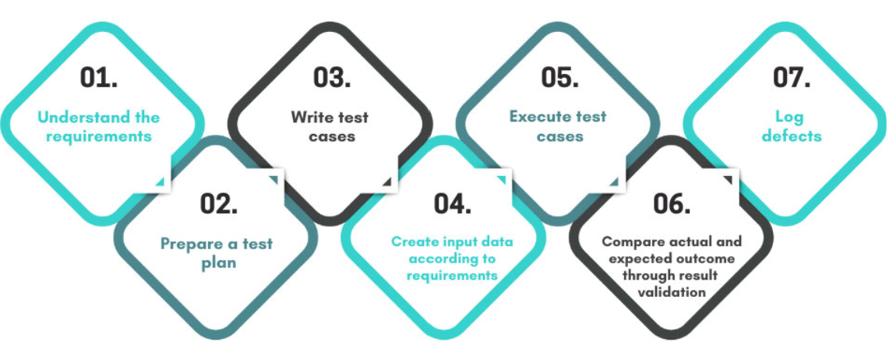
Roles & Responsibilities
Functional Tester Responsibilities-
Test design of user stories- writing test cases and execute the test cases as planned
Work with BA/DEV team to get the functional clarification wherever needed.
Create Test Set & Test Execution In Jira as per the Sprint/Release
Execute manual test cases, capture and analyse results, attach the test evidence in Jira
Log defects if required and track it to closure
Carry out regression testing during the sprint based on the impact.
Maintain the regression suite along with BA - Release on Release
Review the Test cases with the BA and Get sign off
Provide ST results to AT testers for review.
Participate in all Sprint ceremonies and technical discussions.
New CICS Programs
SOAP Web Services
Automation Tester Responsibilities-
Participate in Regression scenario identification
Involve in feasibility check, script development, demo and signoff.
Execution of automated test scripts

Slide 12
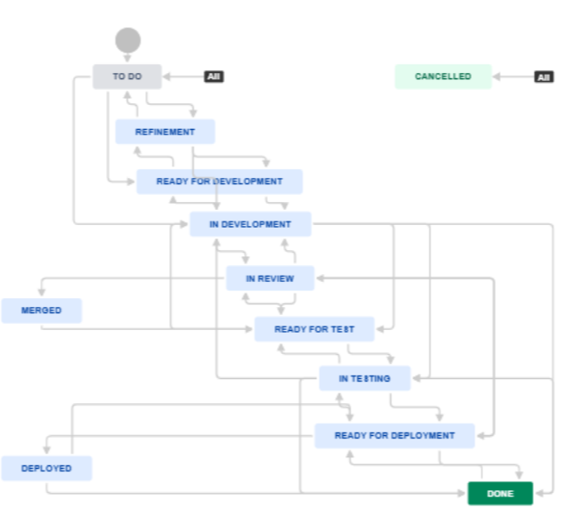
Defect Workflow

Slide 13
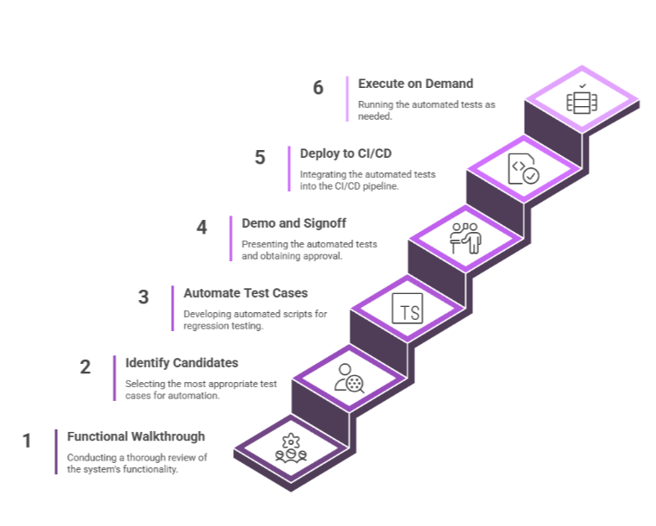
Test Automation Approach .

Slide 14
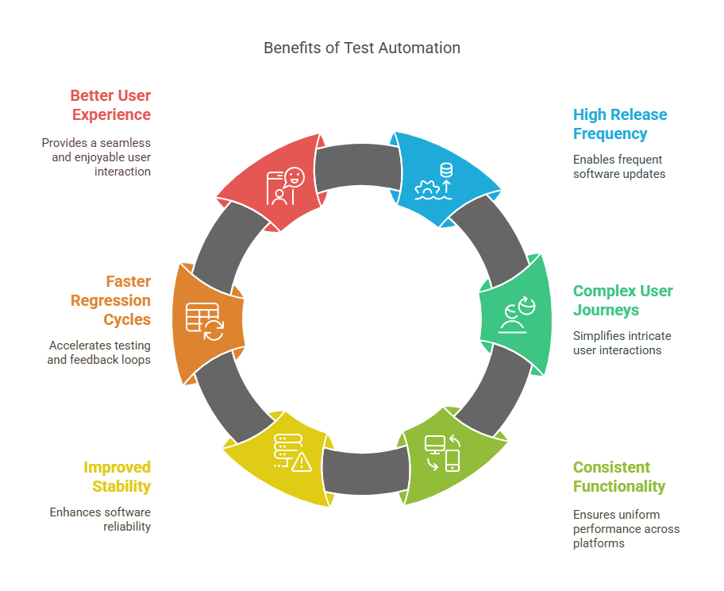
Test Automation Benefits

Slide 15
Current Test Suite Capabilities
Utilizes Playwright and JavaScript for test suite development.
Playwright and JavaScript
Covers CRM Fiber, MC-Sales, SalesEnabler modules comprehensively.
Essential Modules
Integrates with CI pipeline for automated test execution.
Continuous Application Testing
CI Pipeline Integration
Executes tests on schedule and on- demand flexibly.
Test Execution Flexibility
Conducts regression, sanity, and performance testing effectively.
Testing Types

Slide 16
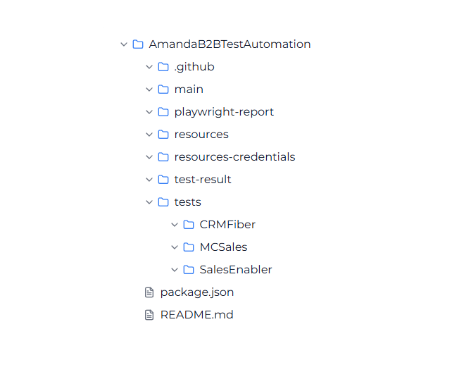
Current Automation Test Suite Structure
GitHub: Manages workflow configurations to control execution within CI/CD pipelines.
PageObjects: Contains all page object classes, which define UI element locators.
Utilities: Stores reusable helper functions and generic logic.
Resources: Serves as a repository for test data and configuration files.
Tests: Includes the actual test cases that are executed during automation runs.

Slide 17
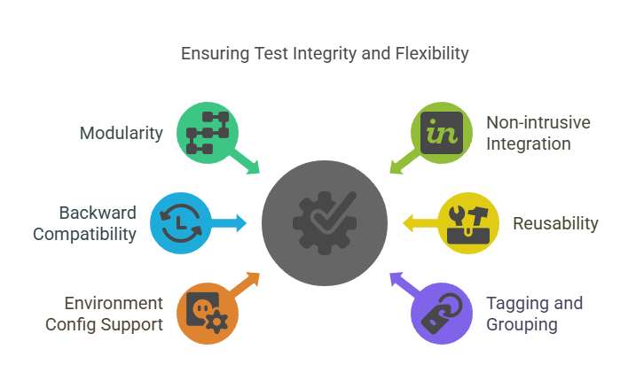
Integration Strategy
New CICS Programs
SOAP Web Services

Slide 18
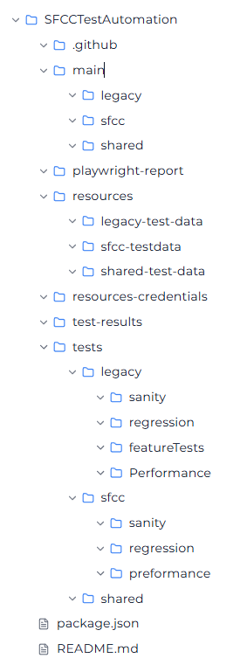
Modifications to folder structure
New CICS Programs
SOAP Web Services

Slide 19
CI/CD setup and reporting metrics
CI/CD setup utilizes GitHub Actions to automate the testing process.
Tests are triggered on:
Scheduled basis.
On-demand basis.
Reporting metrics are generated using Playwright.
Reports provide insights into:
Test execution statistics.
Pass rates.
Trends in test performance.
Helps in continuous improvement.
New CICS Programs
SOAP Web Services

Slide 20
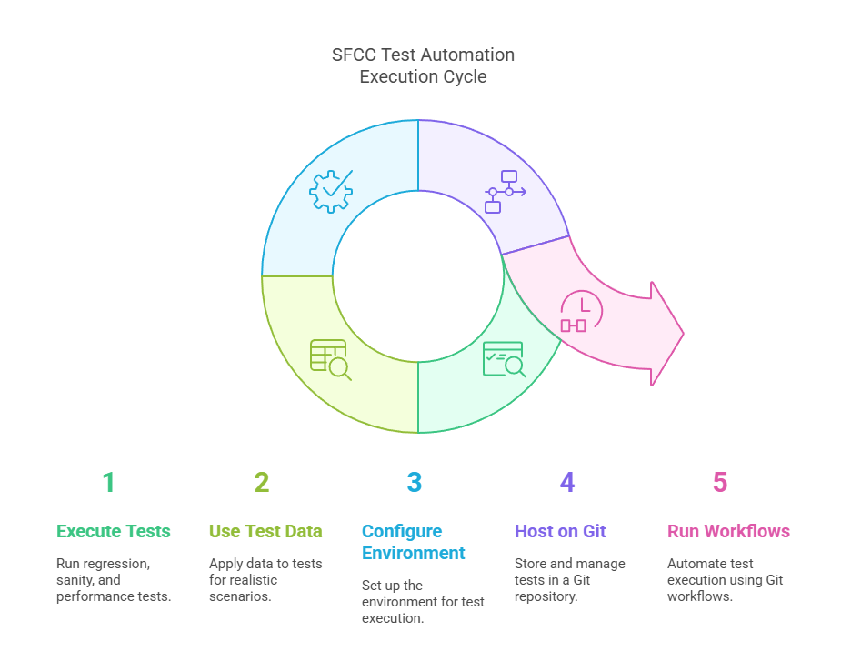
Test Execution

Slide 21
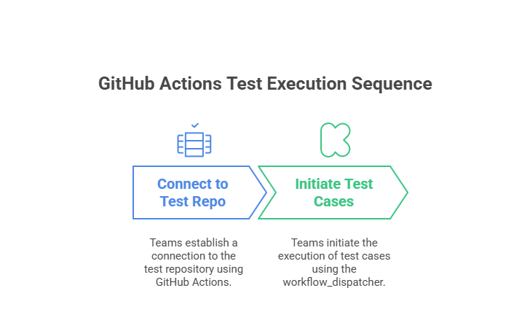
Test automation integrations with cross teams
New CICS Programs
SOAP Web Services

Slide 22
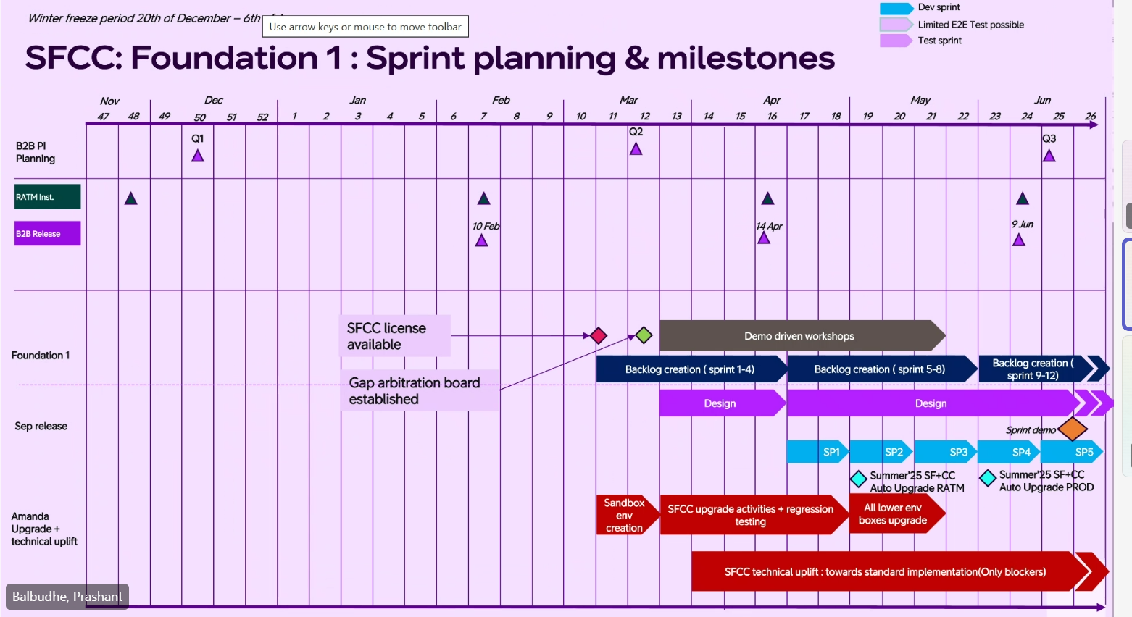
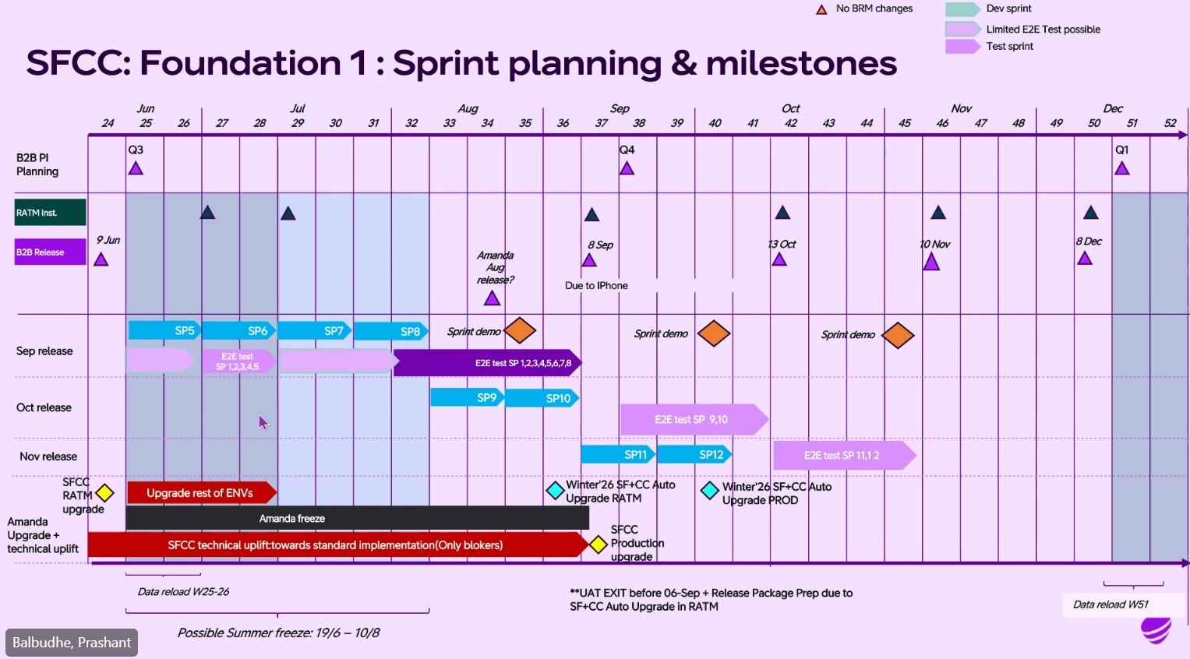
Timelines
Get from Prashant

Slide 23
THANK YOU

